Slide 1
Unit 4 Object-Oriented Design (OOD) with UML
Time: 12 hours
Presented by
Er.Harendra Bikram Shah (Lecturer)
Department of BCA NAST

Slide 2
OUTLINES
Introduction to OOD
Design Concept: Abstraction, Architecture, Patterns, Modularity, Cohesion, Coupling ,Information Hiding, Functional Independence , Refinement
Object-oriented principles: abstraction, encapsulation, inheritance, polymorphism.
Benefits of OOAD in software engineering.
Class diagrams, object diagrams, and sequence diagrams, State machine diagrams, component diagrams, and deployment diagrams.
Introduction to common design patterns such as Singleton, Factory, Observer.
Procedural Design Using Structural Methods, User Interface Design, Human Computer Interaction, Information Presentation, Interface Evaluation, Design Notation

Slide 3
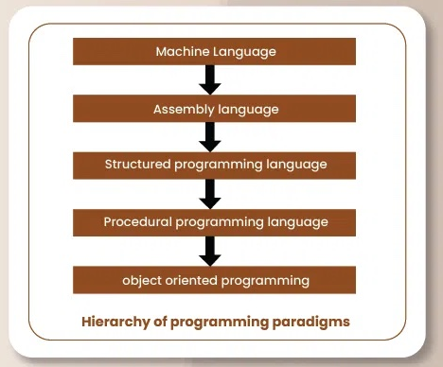
Introduction To OOD
OOD is a programming technique that solves software problems by building a system of interrelated objects.
It makes use of the concepts of classes and objects, encapsulation, inheritance, and polymorphism to model real-world entities and their interactions.

Slide 4
Importance of OOD
Modularity
Reusability
Scalability
Maintainability
Clear Mapping to Real-World Problems
Flexibility and Extensibility
Key Principles of OOD
Encapsulation
Abstraction
Inheritance
Polymorphism
Composition

Slide 5
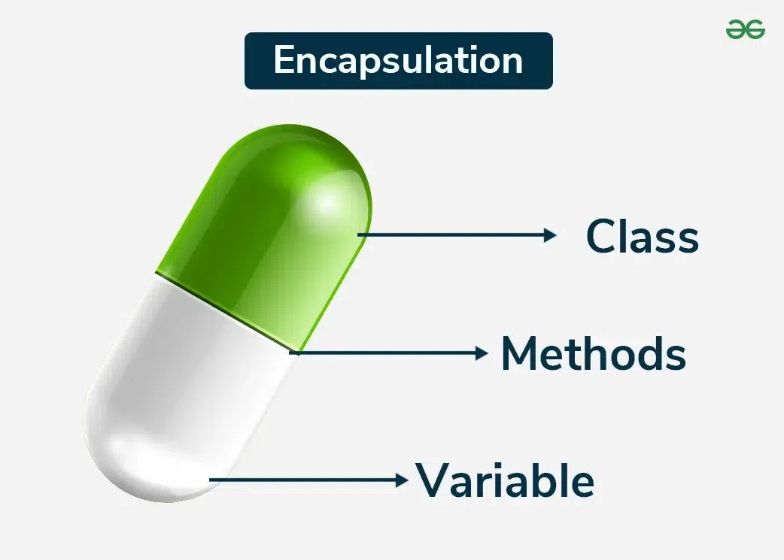
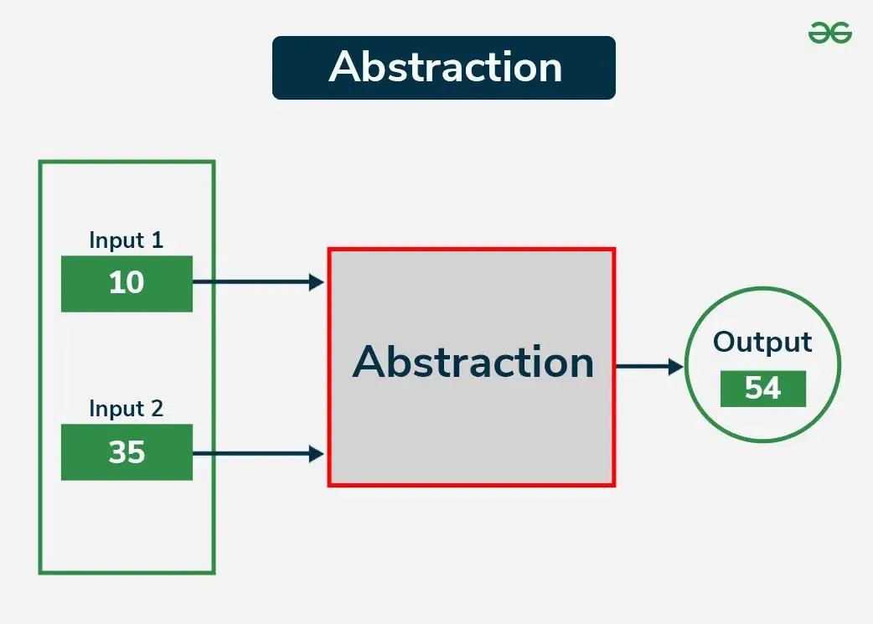
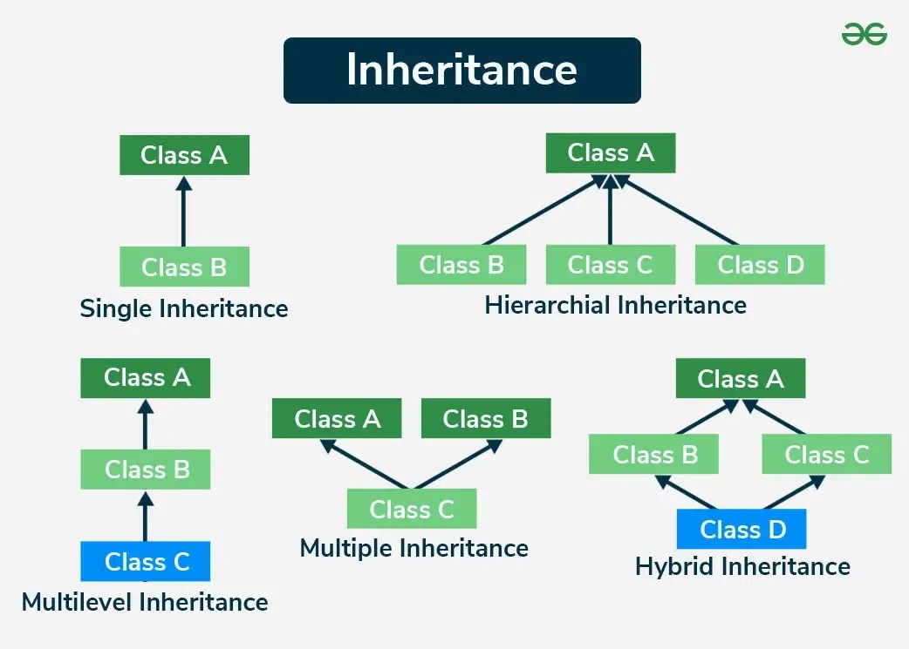
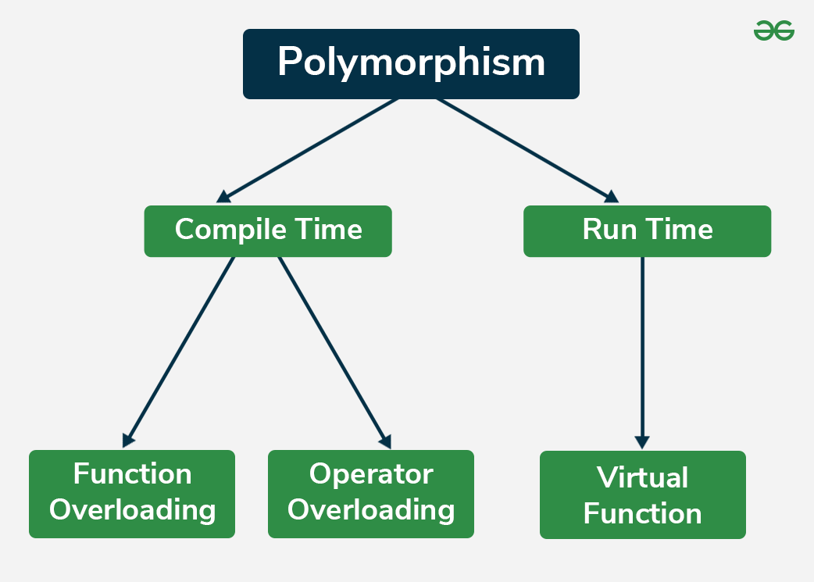
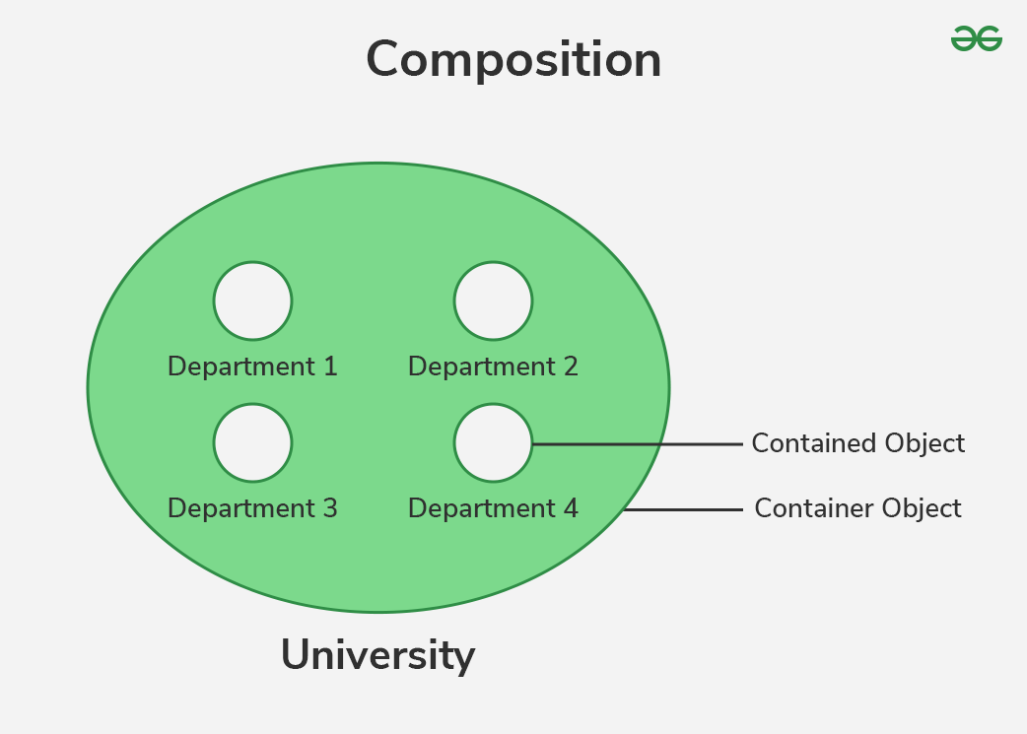
OO Principles of OOD

Slide 6
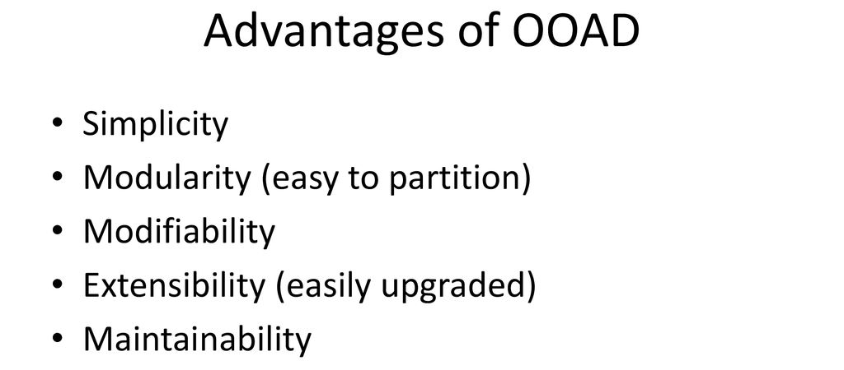
Benefits of OOAD in software engineering

Slide 7
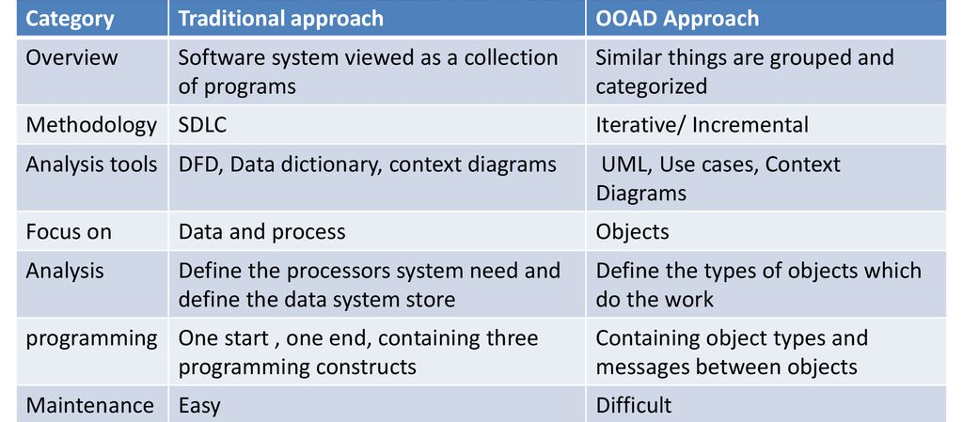
Traditional VS OOAD

Slide 8
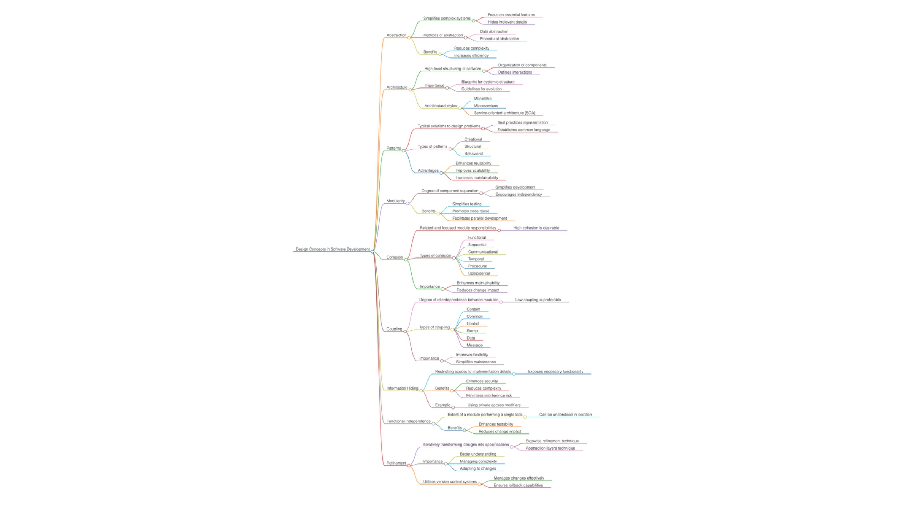
Design Concept

Slide 9
Design Concept

Slide 10
Design Concept

Slide 11
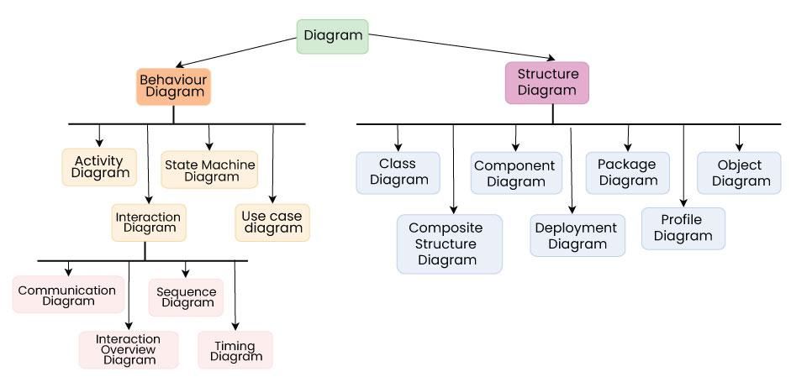
TYPES OF UML DIAGRAM

Slide 12
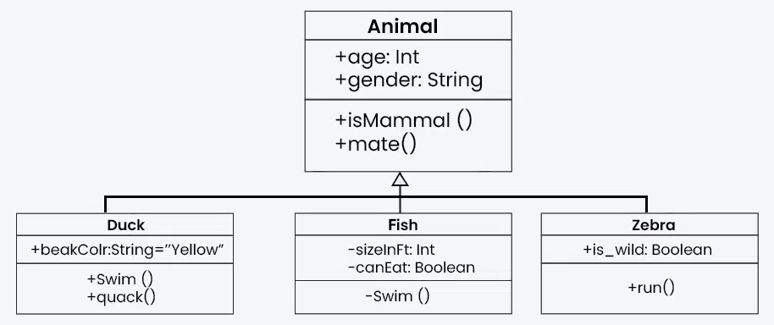
TYPES OF UML DIAGRAM
Structural UML diagrams:
They are visual representations that depict the static aspects of a system, including its classes, objects, components, and their relationships, providing a clear view of the system's architecture.
Types:
1. Class diagrams

Slide 13
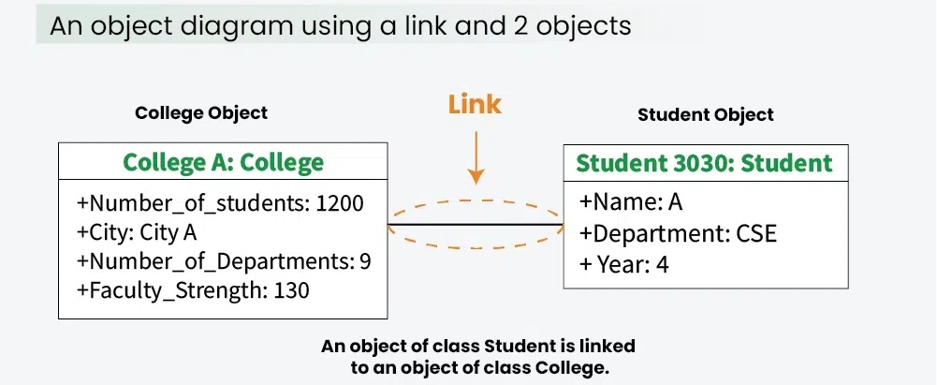
TYPES OF UML DIAGRAM
2. Object diagrams
It can be referred to as a screenshot of the instances in a system and the relationship that exists between them.

Slide 14
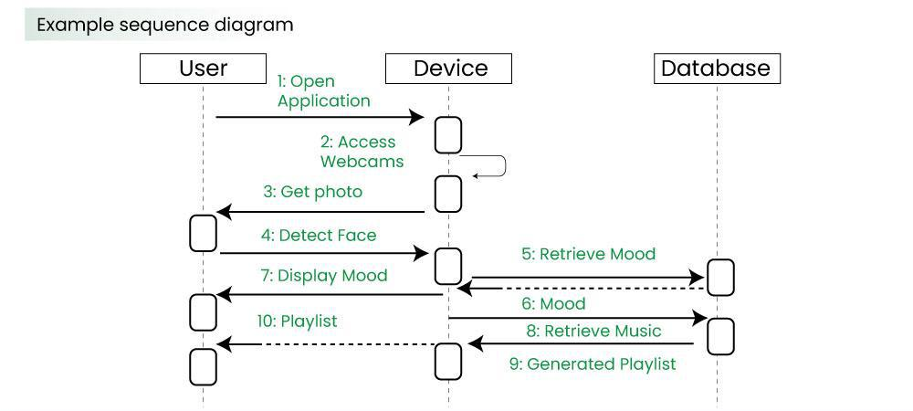
3. sequence diagrams
A sequence diagram simply depicts interaction between objects in a sequential order i.e. the order in which these interactions take place.

Slide 15
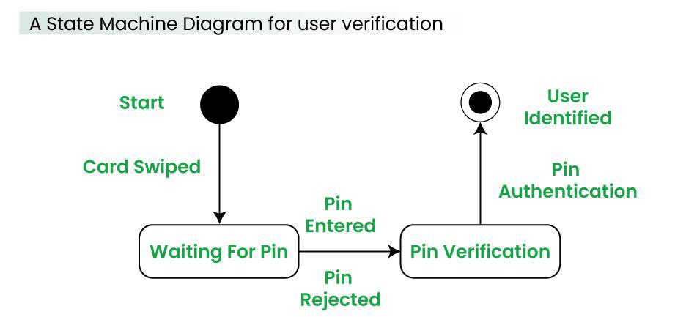
4. State machine diagrams
A state diagram is used to represent the condition of the system or part of the system at finite instances of time.
It’s a behavioral diagram and it represents the behavior using finite state transitions.

Slide 16
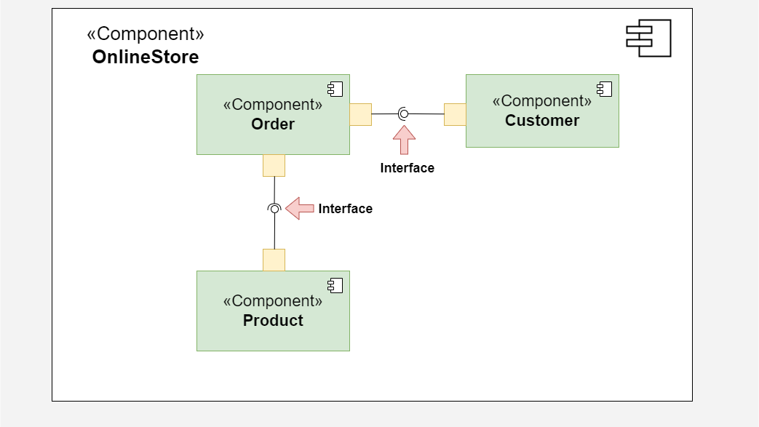
5. component diagrams:
Component diagrams are used to represent how the physical components in a system have been organized.

Slide 17
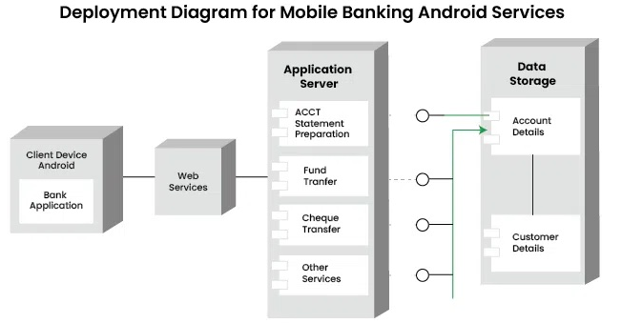
6. Deployment diagrams
Deployment Diagrams are used to represent system hardware and its software

Slide 18
1. Class Diagrams
Advantages:
Easy to understand the overall structure of the system.
Useful for planning object-oriented code.
Applications:
Software architecture design.
Generating code skeletons for applications.
2. Object Diagrams
Advantages:
Help visualize how data looks during execution.
Useful for testing and debugging.
Applications:
Exploring object relationships during runtime.
Validating class diagrams with real data examples.
3. Sequence Diagrams
Advantages:
Make communication between objects easy to understand.
Help identify the order of operations in a system.
Applications:
Designing user interactions or workflows.
Documenting use case scenarios.

Slide 19
4. State Machine Diagrams
Advantages:
Clarify behavior in event-driven systems.
Easy to understand object lifecycle.
Applications:
Modeling control systems or UI states.
Designing embedded systems or workflows.
5. Component Diagrams
Advantages:
Helps manage large systems by breaking them into smaller parts.
Good for understanding system dependencies.
Applications:
Planning modular software design.
Representing external libraries or services used in software.
6. Deployment Diagrams
Advantages:
Useful for visualizing physical system setup.
Helps plan resource distribution.
Applications:
Designing network or cloud-based systems.
Showing how software will be deployed across hardware

Slide 20
Introduction to common design patterns such as Singleton, Factory, Observer
one of the simplest design patterns.
It ensures a class only has one instance, and provides a global point of access to it.

Slide 21
Singleton Design Pattern
Singleton Design Pattern Principles
Single Instance: ensures that only one instance of the class exists throughout the application.
Global Access: Provide a global point of access to that instance.
Lazy or Eager Initialization: Support creating the instance either when needed (lazy) or when the class is loaded (eager).
Thread Safety: Implement mechanisms to prevent multiple threads from creating separate instances simultaneously.
Private Constructor: Restrict direct instantiation by making the constructor private, forcing the use of the access point
Key Components of Singleton
Private Static Instance: A static field that holds the single instance of the class.
Private Constructor: Ensures that no other class can create a new instance.
Public Static Method: Returns the single instance, creating it if it doesn’t already exist.
Lazy Initialization: The instance is created only when it is first needed, saving resources.

Slide 22
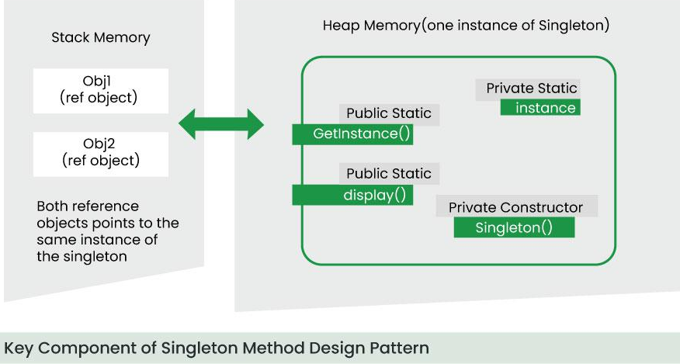
Singleton Design Pattern

Slide 23
Singleton Design Pattern
Java Implementation
Code: Singleton Class
package Singleton; public class singleton { // Step 1: Create a private static instance of the class private static singleton instance; // Step 2: Make the constructor private to prevent instantiation private singleton()
{ System.out.println("Singleton instance created!");} // Step 3: Provide a public static method to access the instance public static singleton getInstance()
{ if (instance == null)
{ instance = new singleton();
} return instance;} // Example method to demonstrate singleton functionality public void showMessage() { System.out.println("Hello from Singleton!"); }
Code: Client Class (Main)
package Singleton; public class Main { public static void main(String[] args)
{ // Access singleton instance singleton singleton1 = singleton.getInstance(); singleton1.showMessage(); // Attempt to create another instance singleton singleton2 = singleton.getInstance(); singleton2.showMessage(); // Verify if both instances are the same System.out.println("Are both instances the same? " + (singleton1 == singleton2)); } }

Slide 24
Singleton Design Pattern
Real-World Examples
1. Logging Service
2. Configuration Manager
3. Database Connection Pool
4. Operating System Printer Spooler
When to Use Singleton
When you need exactly one instance of a class (e.g., database connections, logging, configuration).
When the class must provide a global point of access.
Advantages of Singleton
Controlled Access: Only one instance exists, simplifying resource management.
Lazy Initialization: Saves memory and resources by creating the instance only when needed.
Global Access Point: The single instance is accessible globally.
Disadvantages of Singleton
Tight Coupling: Components that rely on the Singleton are tightly coupled to it.
Difficult Testing: Mocking the Singleton for unit testing can be challenging.
Thread-Safety Issues: In multithreaded environments, multiple instances might be created without proper synchronization.

Slide 25
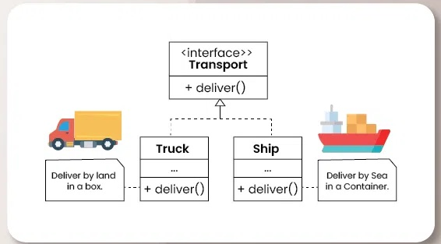
Factory Design Pattern
provides an interface for creating objects in a superclass, allowing subclasses to alter the type of objects that will be created.
This pattern is particularly useful when the exact types of objects to be created may vary or need to be determined at runtime, enabling flexibility and extensibility in object creation.

Slide 26
Factory Design Pattern
When to Use:
When the code needs to create objects without knowing the exact class/type in advance.
When the object creation is complex or involves logic (e.g., selecting between multiple types).
When you want to decouple the instantiation process from the client code.
Key Components:
Product – the common interface or abstract class for all objects the factory creates.
Concrete Product – the actual classes implementing the Product interface.
Creator (Factory) – defines the factory method to return Product objects.
Concrete Creator – overrides the factory method to return specific Concrete Products.
Advantages:
Loose coupling between client code and the actual object creation.
Code becomes more maintainable and scalable.
Makes it easier to introduce new types of products without changing existing code.
Disadvantages:
May lead to lots of classes in larger projects.
Slightly increased complexity compared to simple instantiation (new keyword).

Slide 27
Factory Design Pattern
// Product interface
interface Shape {
void draw();
}
// Concrete Products
class Circle implements Shape {
public void draw() { System.out.println("Drawing Circle"); }
}
class Square implements Shape {
public void draw() { System.out.println("Drawing Square"); }
}
// Factory Class
class ShapeFactory {
public Shape getShape(String type) {
if (type.equalsIgnoreCase("CIRCLE")) {
return new Circle();
} else if (type.equalsIgnoreCase("SQUARE")) {
return new Square();
}
return null;
}
}
// Client Code
public class Main {
public static void main(String[] args) {
ShapeFactory factory = new ShapeFactory();
Shape shape1 = factory.getShape("CIRCLE");
shape1.draw(); // Output: Drawing Circle
}
}

Slide 28

Observer Design Pattern
The Observer Design Pattern is a behavioural design pattern that defines a one-to-many dependency between objects.
When one object (the subject) changes state, all its dependents (observers) are notified and updated automatically.

Slide 29
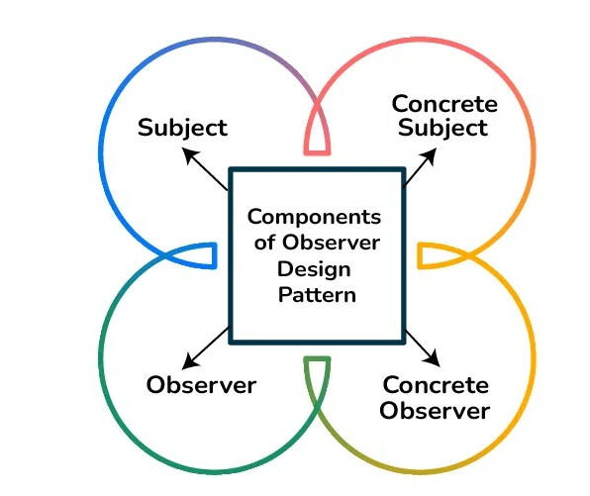
Observer Design Pattern

Slide 30
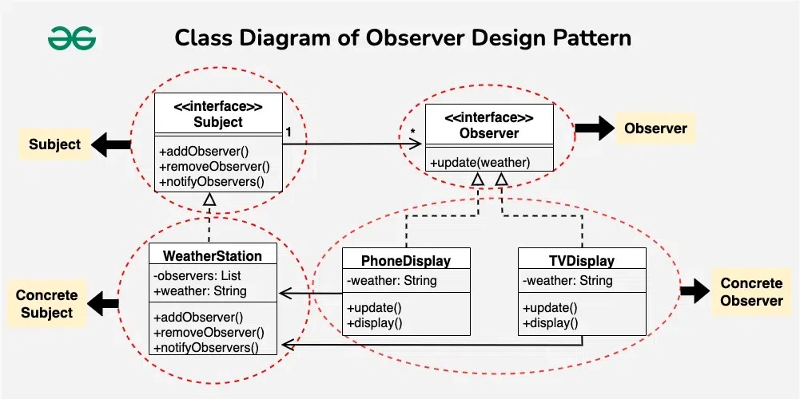
Observer Design Pattern

Slide 31
Observer Design Pattern
Advantages:
Promotes loose coupling between subject and observers.
Supports broadcast communication (subject notifies all observers).
Easy to add new observers without changing subject code.
Disadvantages:
Can lead to unexpected updates if not handled carefully.
Potential memory leaks if observers are not removed properly.
Debugging can become harder with many observers.

Slide 32
Observer Design Pattern
// Observer interface
interface Observer {
void update(String message);
}
// Subject interface
interface Subject {
void attach(Observer o);
void detach(Observer o);
void notifyObservers();
}
// Concrete Subject
class NewsAgency implements Subject {
private List<Observer> observers = new ArrayList<>();
private String news;
public void setNews(String news) {
this.news = news;
notifyObservers();
}
// Concrete Observer
class NewsChannel implements Observer {
private String channelNews;
public void update(String news) {
this.channelNews = news;
System.out.println("NewsChannel received: " + news);
}
}
// Client
public class Main {
public static void main(String[] args) {
NewsAgency agency = new NewsAgency();
NewsChannel channel1 = new NewsChannel();
NewsChannel channel2 = new NewsChannel();
agency.attach(channel1);
agency.attach(channel2);
agency.setNews("New Drone Policy Announced!");
}
}
public void attach(Observer o) { observers.add(o); }
public void detach(Observer o) { observers.remove(o); }
public void notifyObservers() {
for (Observer o : observers) {
o.update(news);
}}}

Slide 33
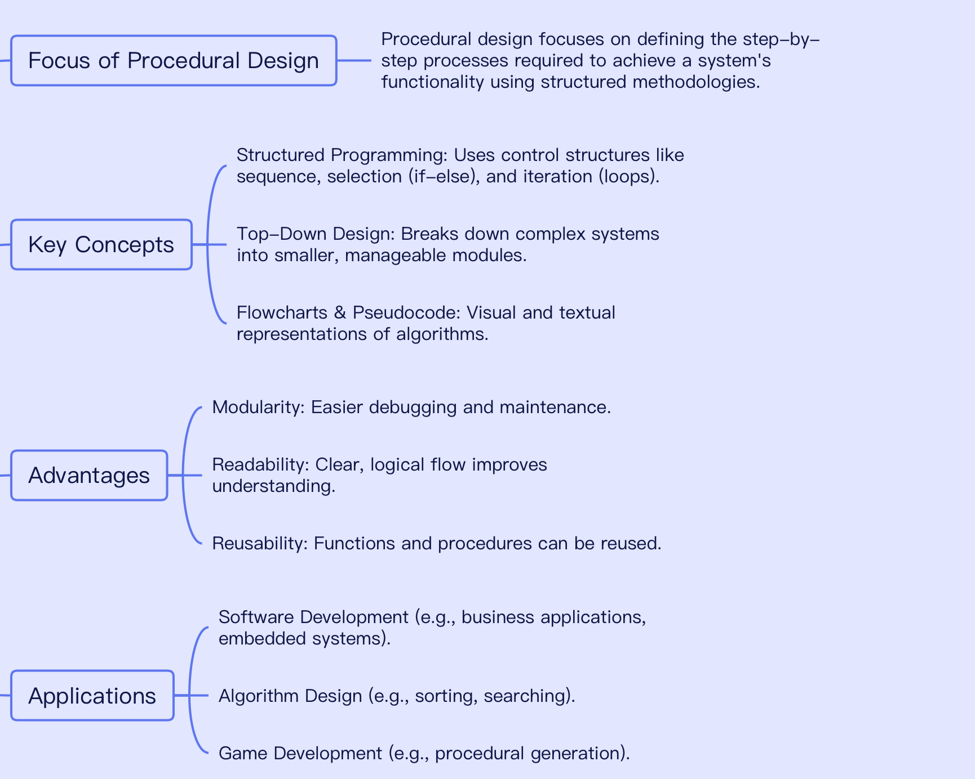
Procedural Design Using Structural Methods, User Interface Design, Human Computer Interaction, Information Presentation, Interface Evaluation, Design Notation

Slide 34
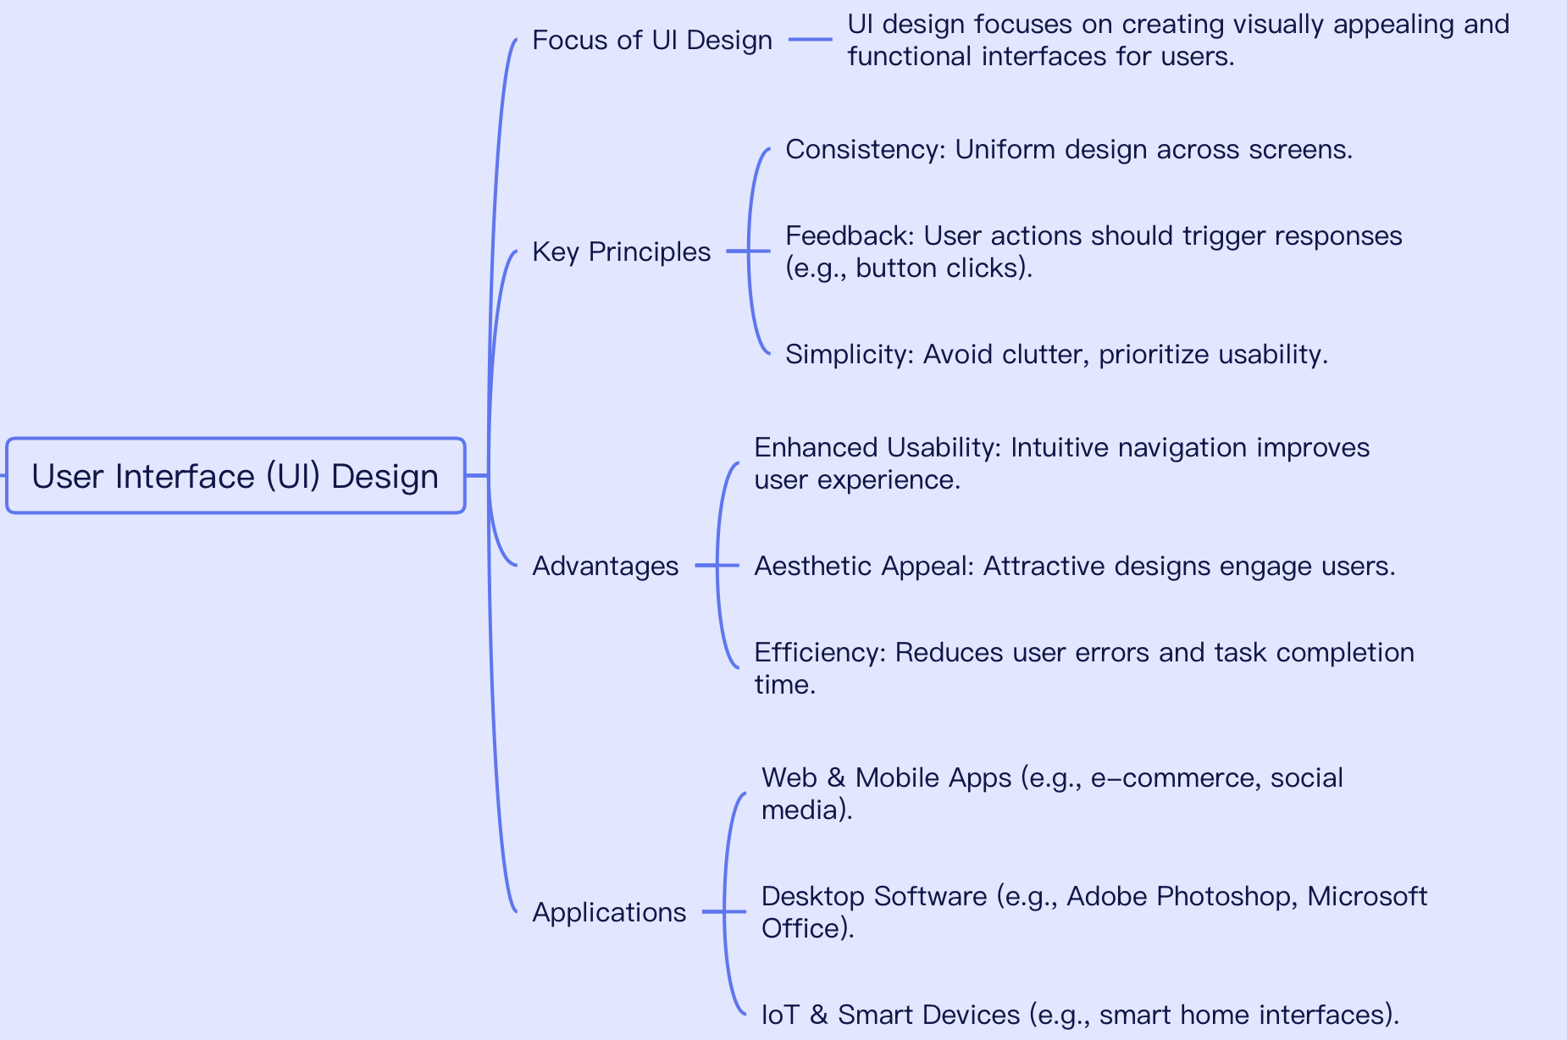
User Interface Design

Slide 35
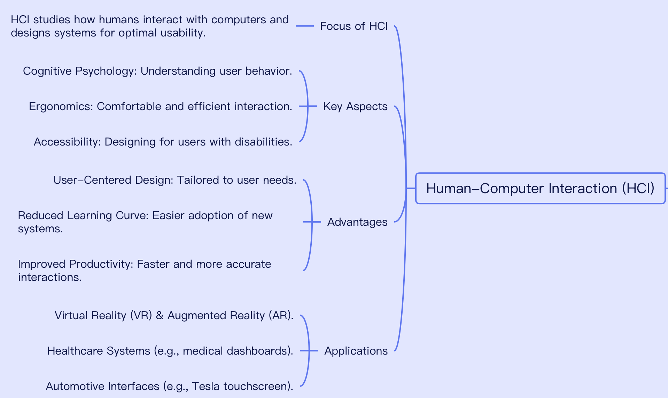
Human Computer Interaction

Slide 36
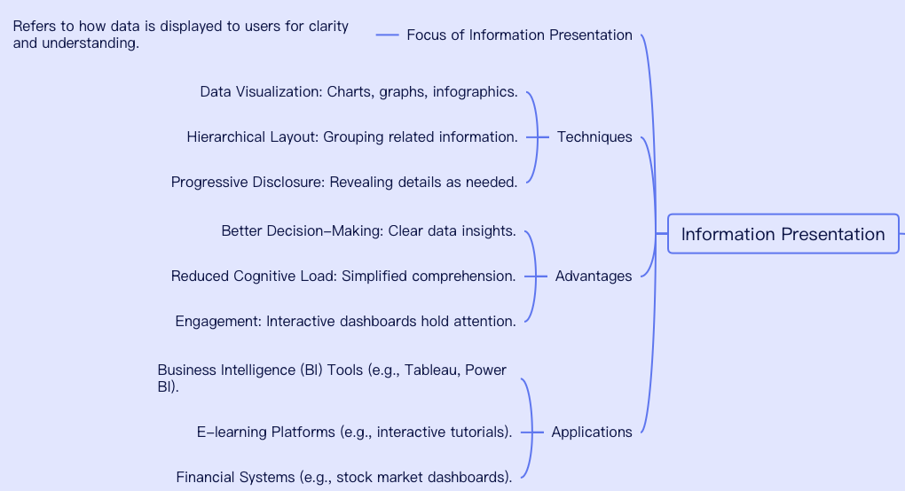
Information Presentation

Slide 37
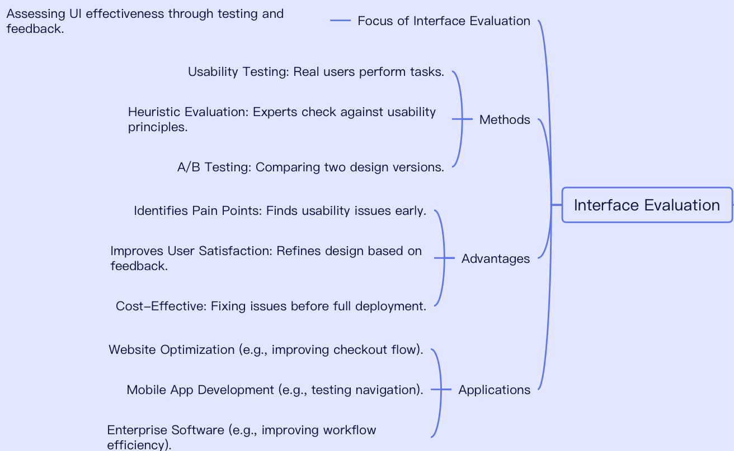
Interface Evaluation

Slide 38
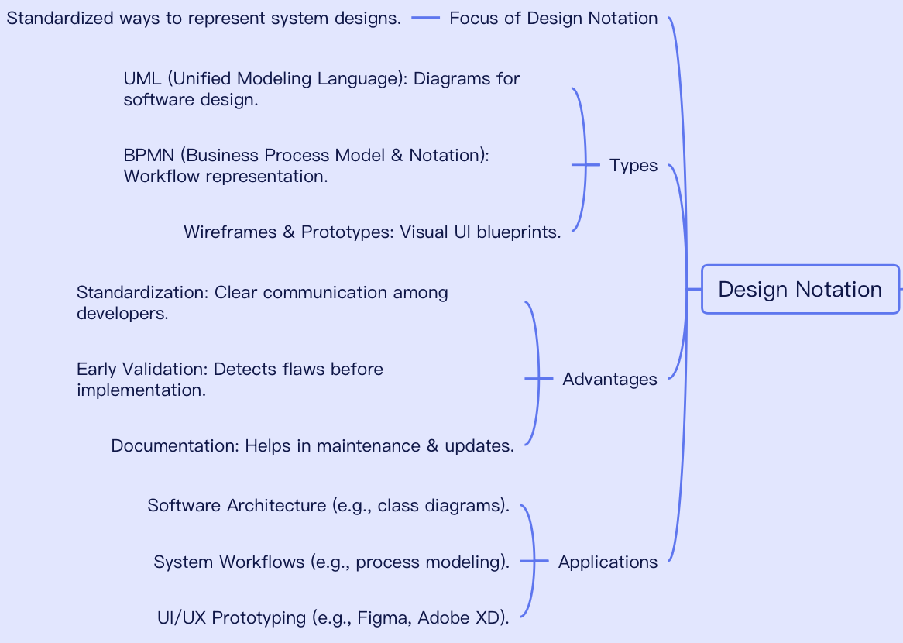
Design Notation

Slide 39
THANK YOU

